Slide 1

Unit-IV
Queues

Slide 2
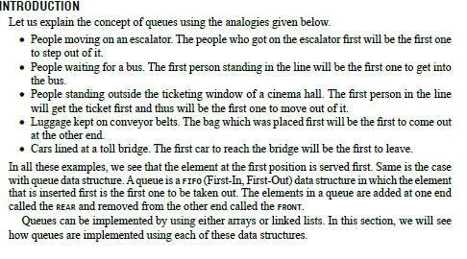
INTRODUCTION

Slide 3
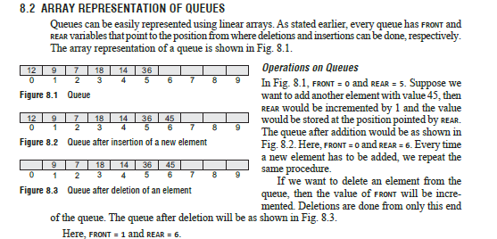
ARRAY REPRESENTATION OF QUEUEs

Slide 4
Data Structure of Queue
CREATEQ(Q) which creates Q as an empty queue;
ADDQ(i,Q) which adds the element i to the rear of a queue and returns the new queue;
DELETEQ(Q) which removes the front element from the queue Q and returns the resulting queue;
FRONT(Q) which returns the front element of Q;
ISEMTQ(Q) which returns true if Q is empty else false.

Slide 5
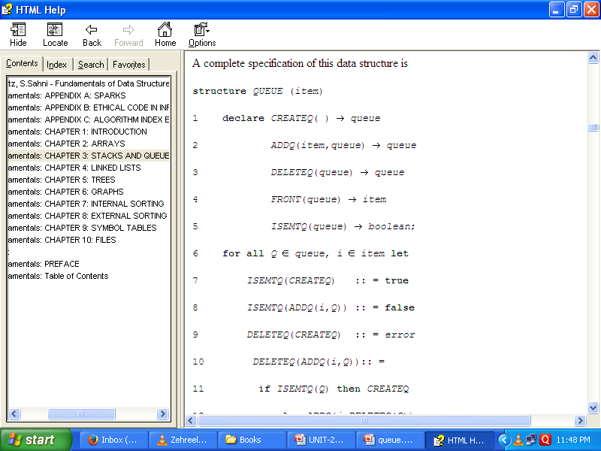

Slide 6
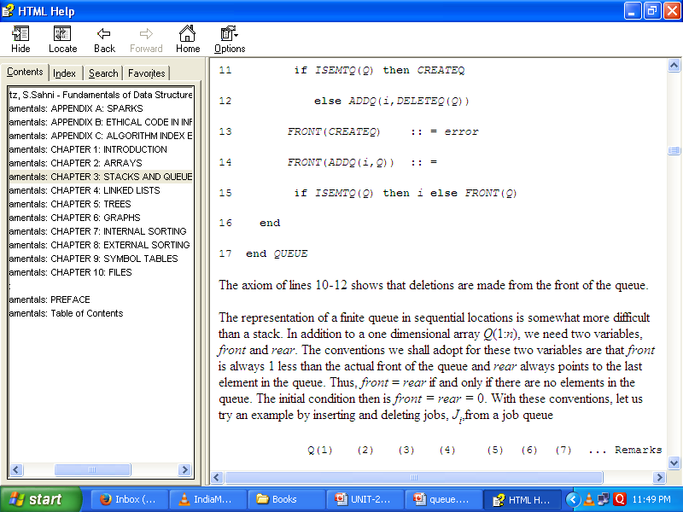

Slide 7
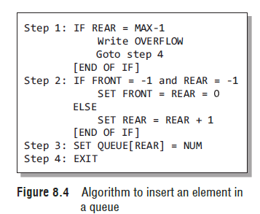
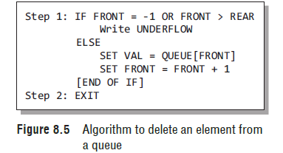

Slide 8
LINKED REPRESENTATION OF QUEUES
We have seen how a queue is created using an array. Although this technique of creating a queue, is easy, its drawback is that the array must be declared to have some fixed size. If we allocate space for 50 elements in the queue and it hardly uses 20–25 locations, then half of the space will be wasted. And in case we allocate less memory locations for a queue that might end up growing large and large, then a lot of re-allocations will have to be done, thereby creating a lot of overhead and consuming a lot of time. In case the queue is a very small one or its maximum size is known in advance, then the array implementation of the queue gives an efficient implementation. But if the array size cannot be determined in advance, the other alternative, i.e., the linked representation is used. The storage requirement of linked representation of a queue with n elements is O(n) and the typical time requirement for operations is O(1). In a linked queue, every element has two parts, one that stores the data and another that stores the address of the next element. The START pointer of the linked list is used as FRONT. Here, we will also use another pointer called REAR, which will store the address of the last element in the queue.
All insertions will be done at the rear end and all the deletions will be done at the front end. If
FRONT = REAR = NULL, then it indicates that the queue is empty. The linked representation of a queue is shown in Fig.

Slide 9
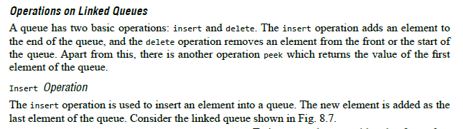

Slide 10
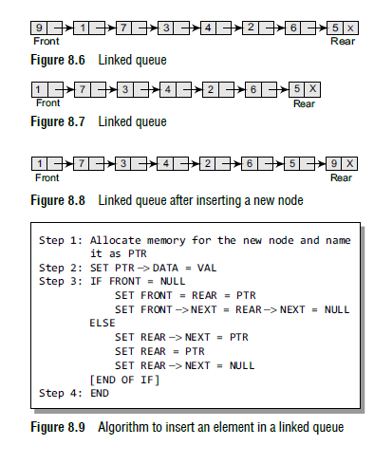

Slide 11
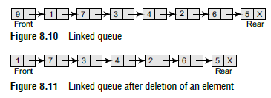

Slide 12
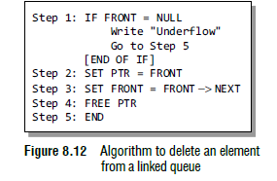

Slide 13
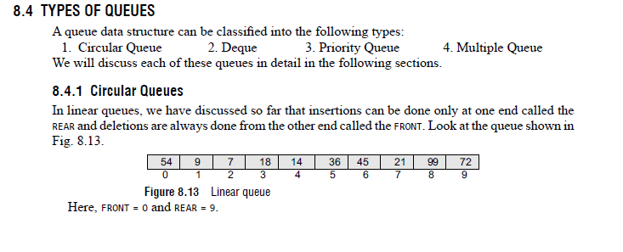
TYPES OF QUEUES

Slide 14
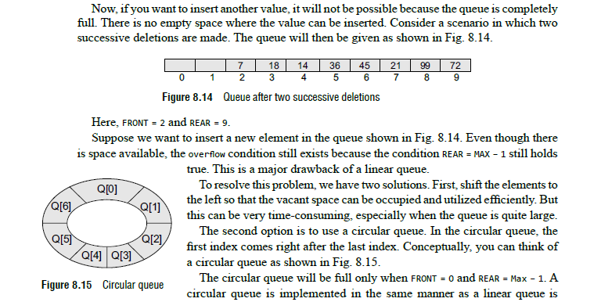

Slide 15
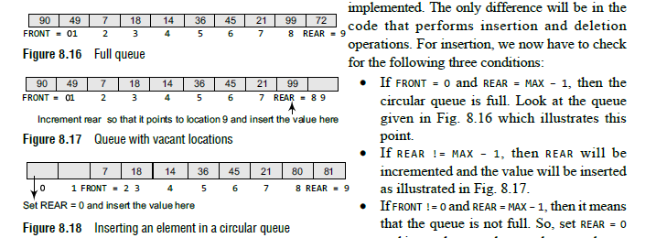

Slide 16
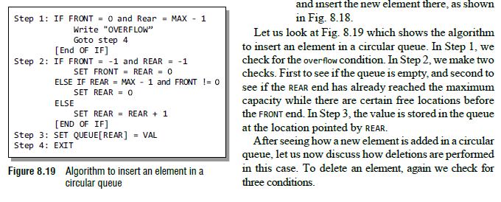

Slide 17
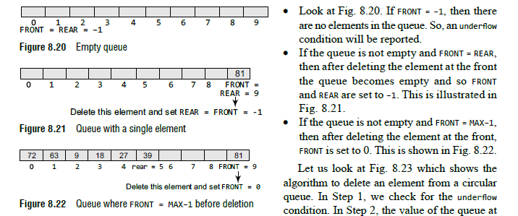

Slide 18
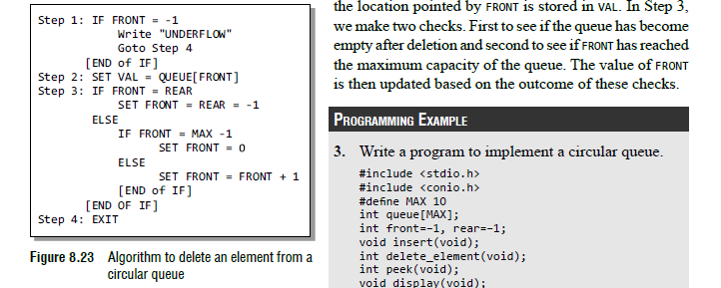

Slide 19
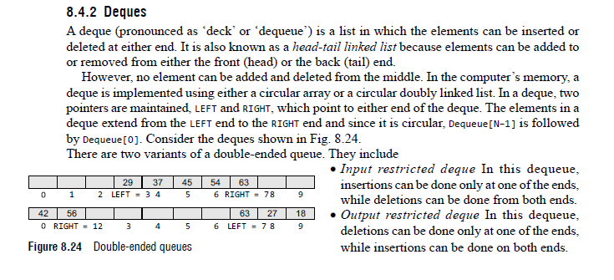
Deques

Slide 20
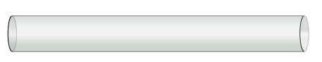

Double Ended Queue
In Double ended queue, the elements can be added and deleted from rear as well as front end.
front
rear

Slide 21
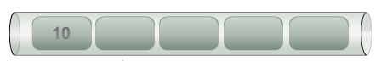
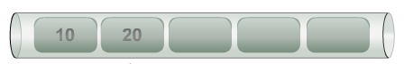
Operations on Double Ended Queue
Example: To insert 10, 20, 30 & 40 in the doubly queue from rear end.
front
front
rear
rear
1
2

Slide 22
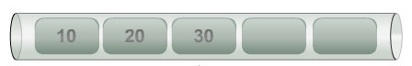
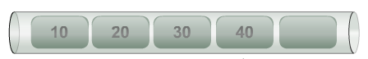
Operations on Double Ended Queue
front
front
rear
rear
3
4
Play Queues Video from DVD

Slide 23
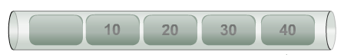
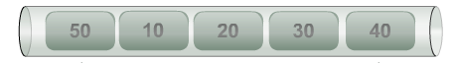
Operations on Double Ended Queue
Example: To insert 50 in the doubly queue from front end.
front
rear
front
rear
1
2
Play Queues Video from DVD

Slide 24
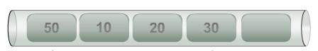
Operations on Double Ended Queue
Example: To delete an element from the doubly queue from rear end.
front
rear
front
rear
1
2
Play Queues Video from DVD

Slide 25
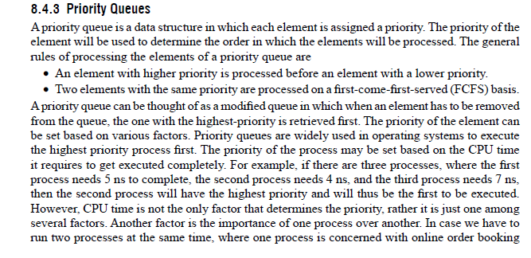
Priority Queues

Slide 26
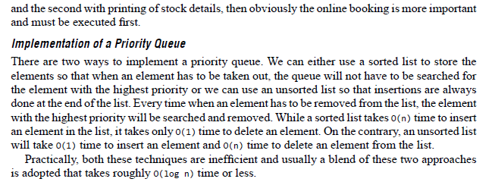

Slide 27
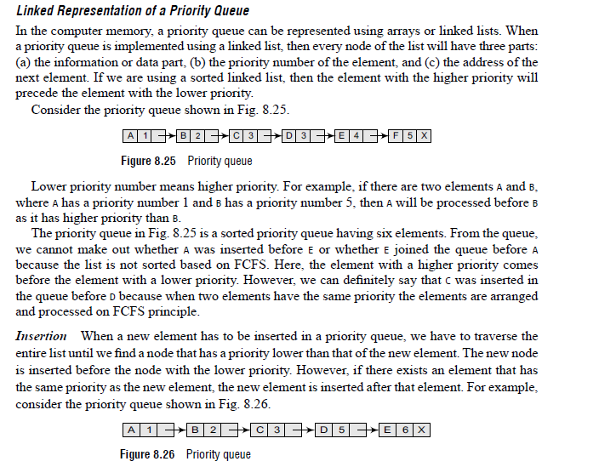

Slide 28
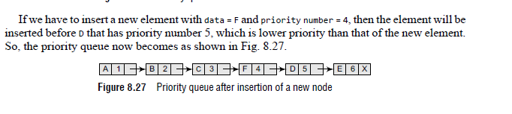

Slide 29
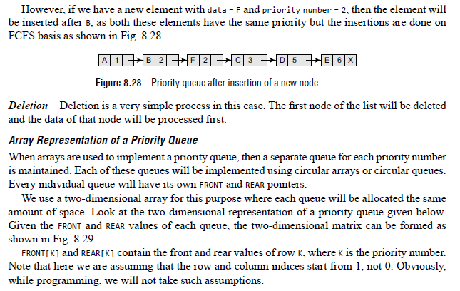

Slide 30
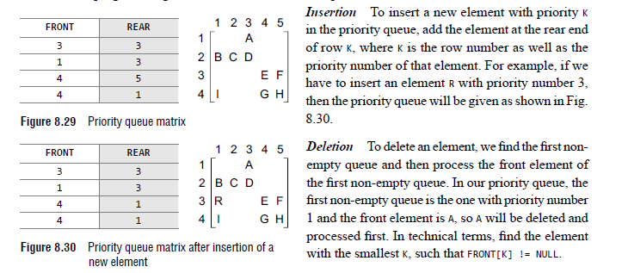

Slide 31
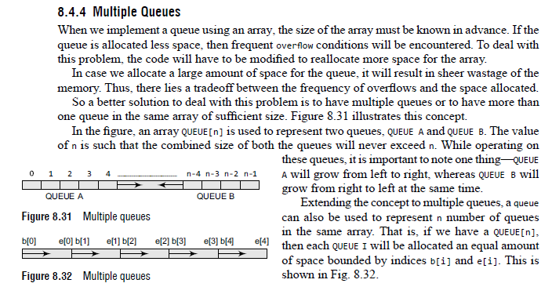
Multiple Queues

Slide 32
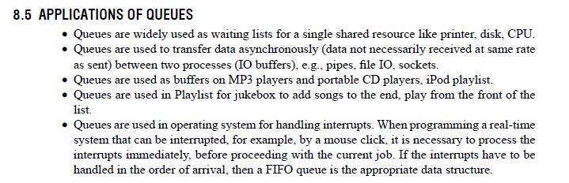
APPLICATIONs OF QUEUES

Slide 33
Applications of Queue
Scheduling of processes.
Spooling i.e. to maintain a queue of jobs to be printed.
A queue of client processes waiting to receive the service from the server process.
Various application software using non-linear data structure tree or graph requires a queue for breadth first traversal.
Simulation of real life problem.

